Slide 1
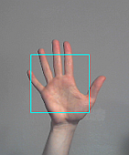
Real-Time Hand Gesture Recognition

Slide 2
Team Members
Akhil Mathew – 100799990
Neenu Markose - 100799975

Slide 3
Table of Content
Introduction
Objective
Process Flow
About the Dataset
Image Labelling
Data Samples
Model
Train & Test Split
Label Mapping & TF Record
Model Training
Model Evaluation
Prediction
Conclusion

Slide 4
Introduction
Object Detection is the technology of deep learning, where objects in the image or video can be detected and labeled with their respective names.
We are familiar with different applications of object detection in real life- face detection, number-plate recognition, video surveillance, etc.
There are still open platforms that can be benefited from object detection and its applications.
We are trying to utilize the features of object detection to create a useful model.

Slide 5
Objective
Our hands are a useful tool for adding meaning to our communication.
Especially, Deaf and hard-of-hearing individuals use hand gestures for communication.
Normal people feel difficulty in recognizing their language by signs made.
There is a necessity for a system that recognizes hand gesture language.
The objective of this project is to create a model which can recognize hand gesture language

Slide 6
Collect images and label them using LabelImg.
Transfer Learning using SSD MobileNet on the collected dataset.
Real-time detection using a webcam with OpenCV library.
Process Flow

Slide 7
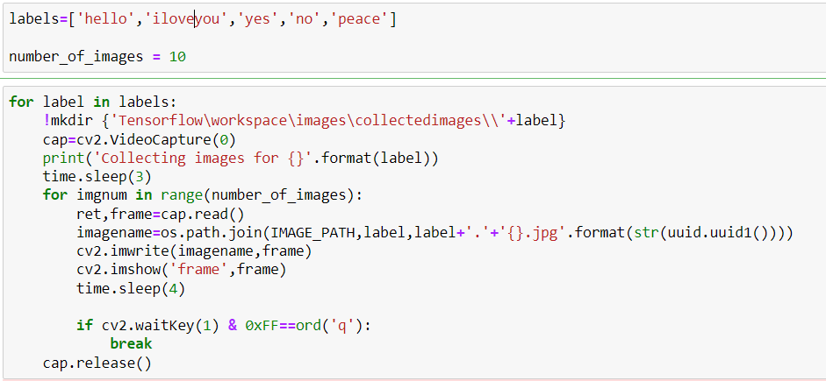
About the Dataset
Prepared a custom dataset for hand gesture recognition.
Collected data manually by running code in the Jupyter notebook.
Images collected for five labels which are:
Hello
I love you
Yes
No
Peace
20 images were collected for each label.

Slide 8
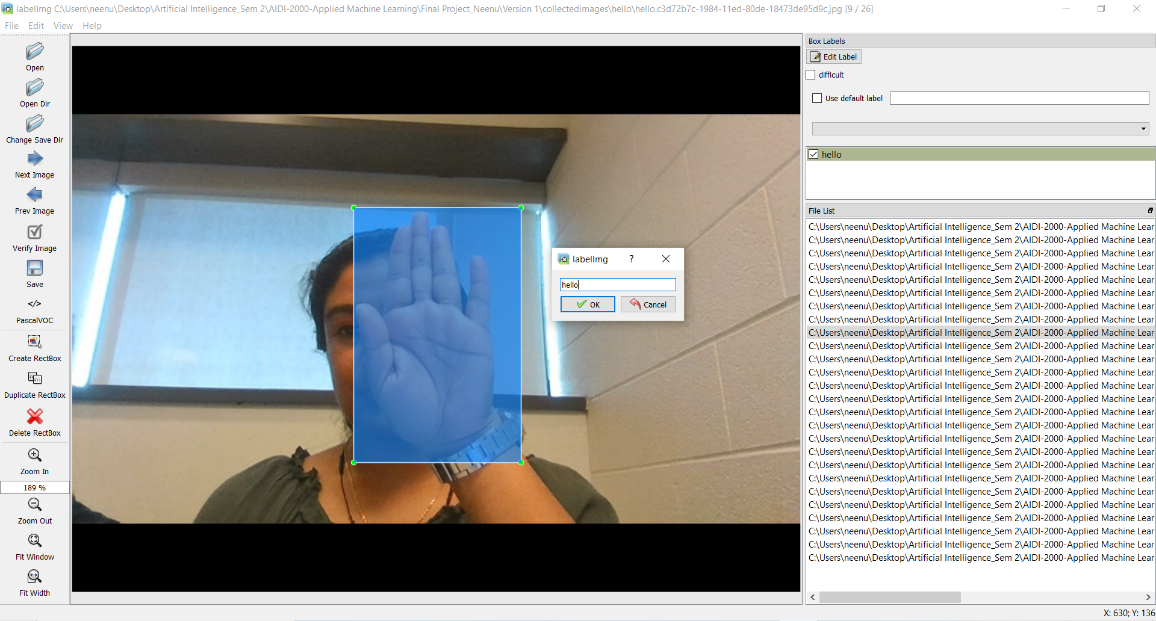
Image Labelling
We used LabelImg API for the image annotation or data labeling.
A graphical image annotation tool that gives images with bounding boxes after labeling them.
It uses Qt for its graphical user interface and is developed in Python.
ImageNet's PASCAL VOC format is utilized to record the output labeled data as XML files.

Slide 9
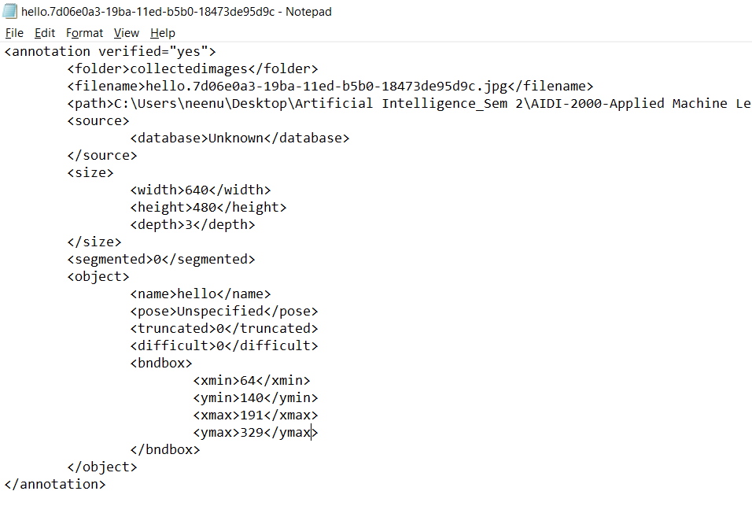
Image Labelling
XML files contain pieces of information like
Labels
bounding box values
image width, height, and color channels.

Slide 10
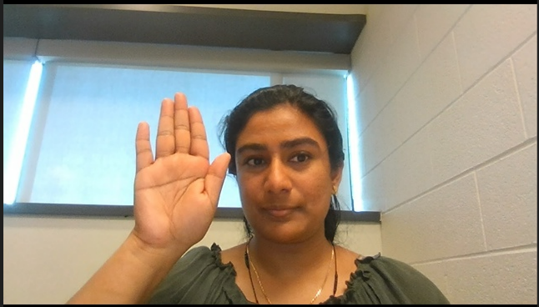

Data Samples
HELLO
YES

Slide 11
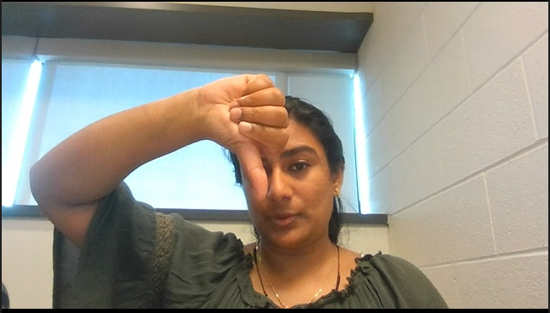

Data Samples
NO
PEACE

Slide 12
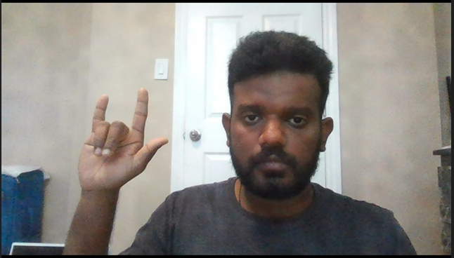
Data Samples
I LOVE YOU

Slide 13
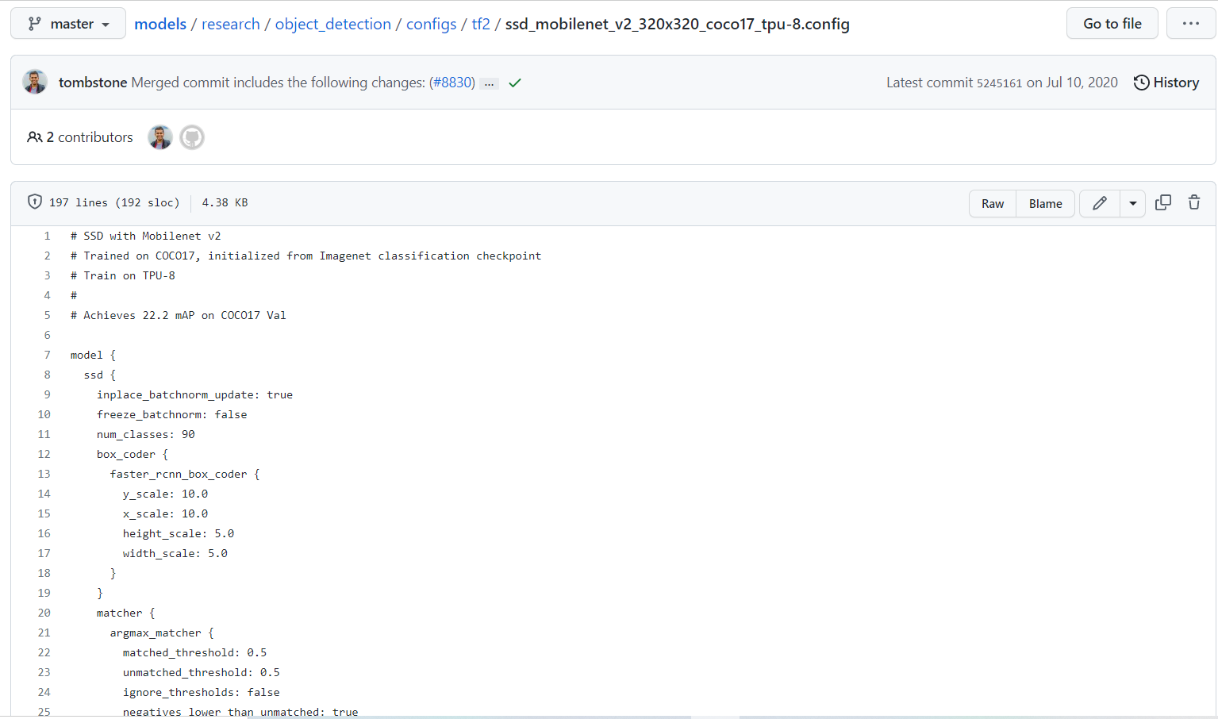
Model
A Single-Shot Multibox Detection (SSD) network designed for object detection is the mobilenet-SSD model (ssd_mobilenet_v2_fpnlite_320x320_coco17_tpu-8). The Caffe framework is utilized to create this model.
The model input is a blob that consists of a single image of 1, 3, 300, 300 in BGR order.
https://github.com/tensorflow/models/blob/master/research/object_detection/g3doc/tf2_detection_zoo.md

Slide 14
Collected data is divided into test and train
Images and their XML files were saved into two folders as test and train.
Train & Test Split

Slide 15
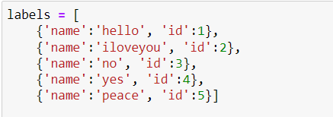
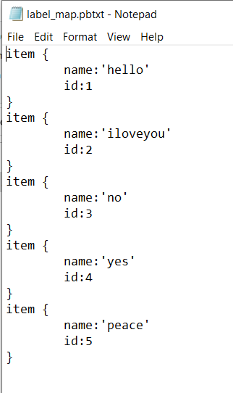
Label Mapping & TF Record
Each label is mapped to an integer value.
These integer values will be used in the training and detection process.
Its is a separate record for class annotations in TensorFlow.
A series of binary records can be stored in the TFRecord format.
Train and Test data converted in the binary form and stored into the tensorflow/workspace/annotations/ path.

Slide 16
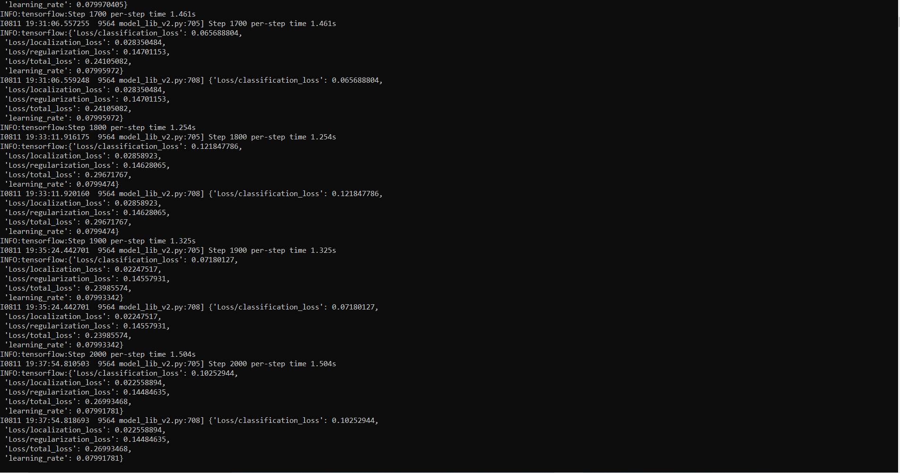
Model Training
Copied the pre-trained SSD MobileNet model and updated config for transfer learning.
Trained the training dataset on the model.
num_train_steps or the epochs used is 2000.

Slide 17
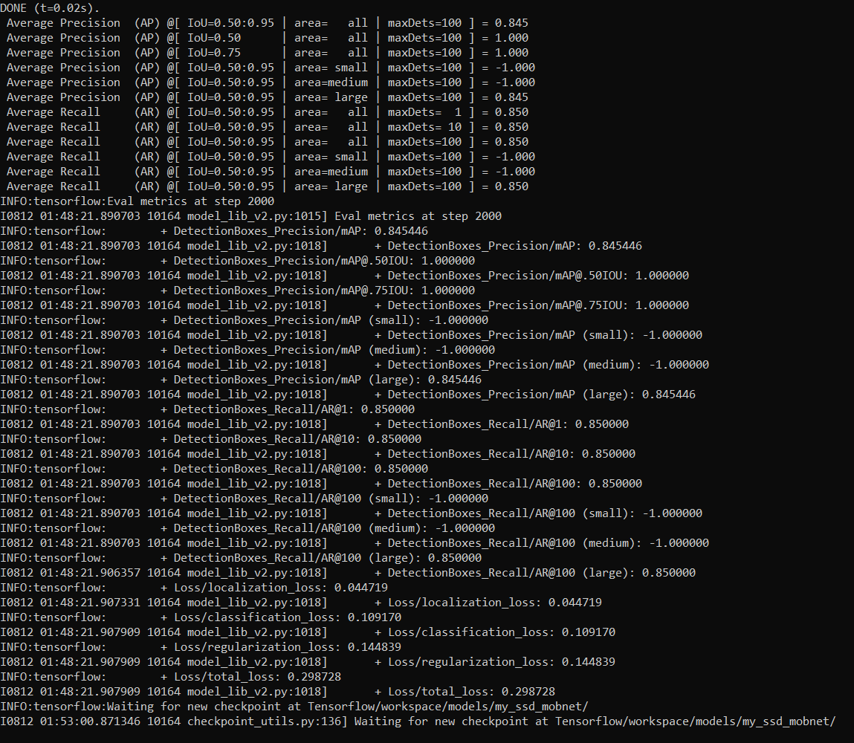
Model Evaluation
Evaluation metric at step 2000.
Average Precision obtained for the model is 0.845.
Average Recall = 0.850
Total loss is 0.298728.

Slide 18
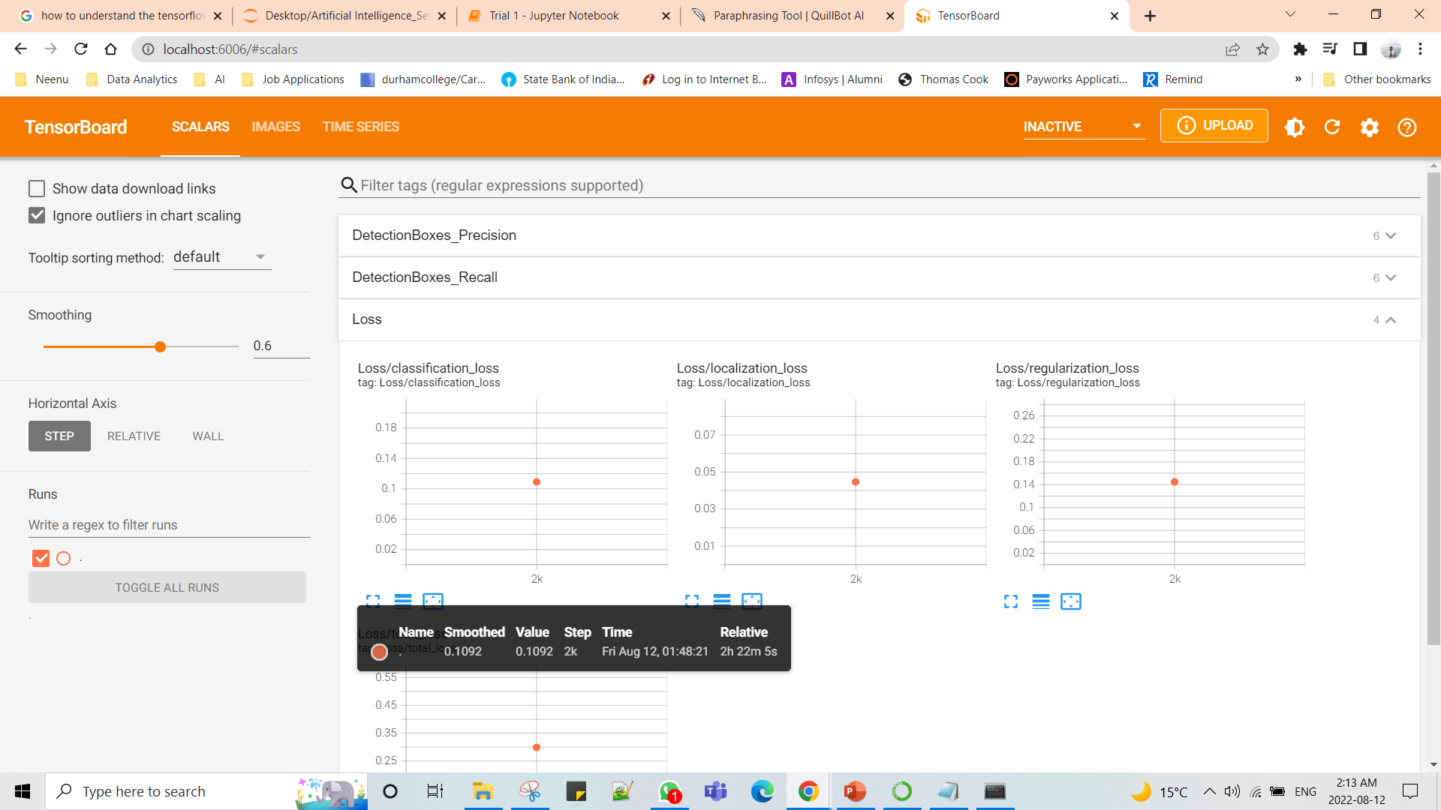
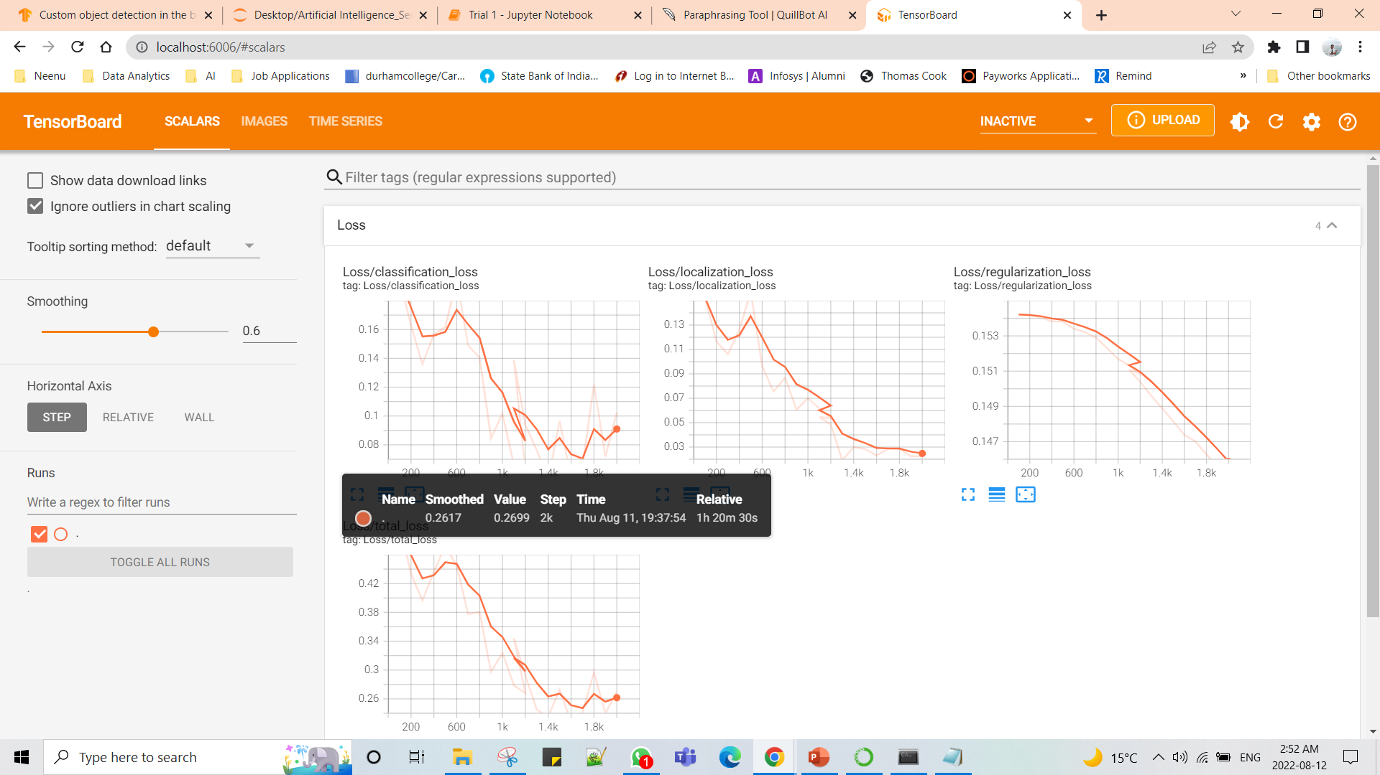
Model Evaluation

Slide 19
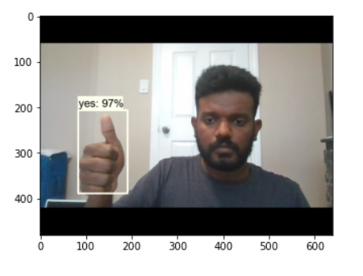
Prediction
Predicted the model on an image from the test dataset.
Image predicted correctly with 97% of accuracy.

Slide 20
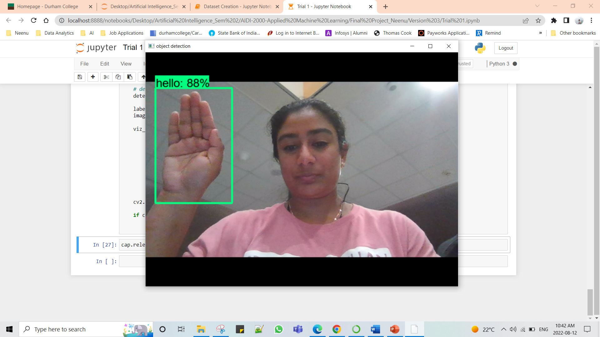
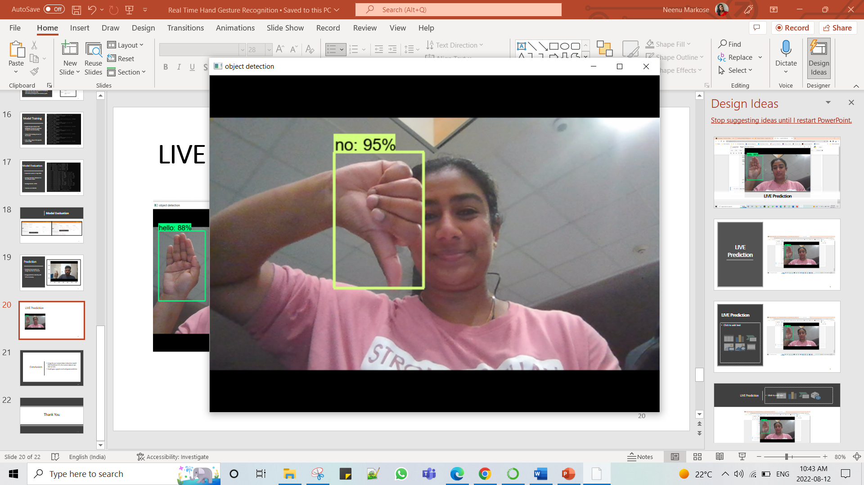
LIVE Prediction

Slide 21
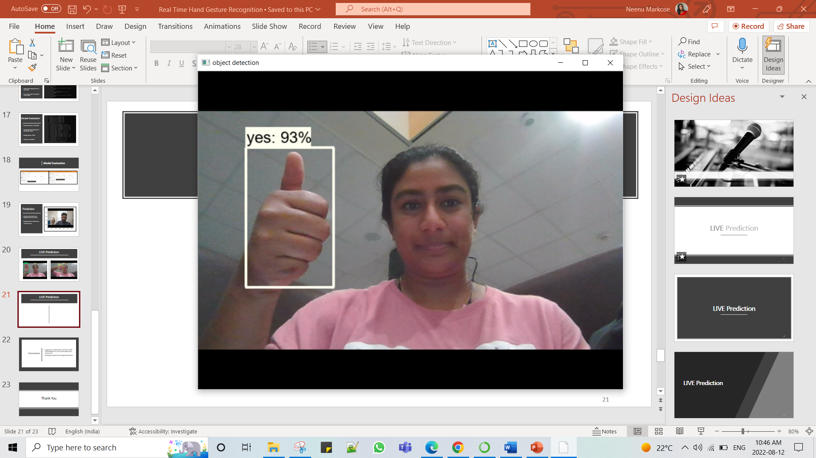
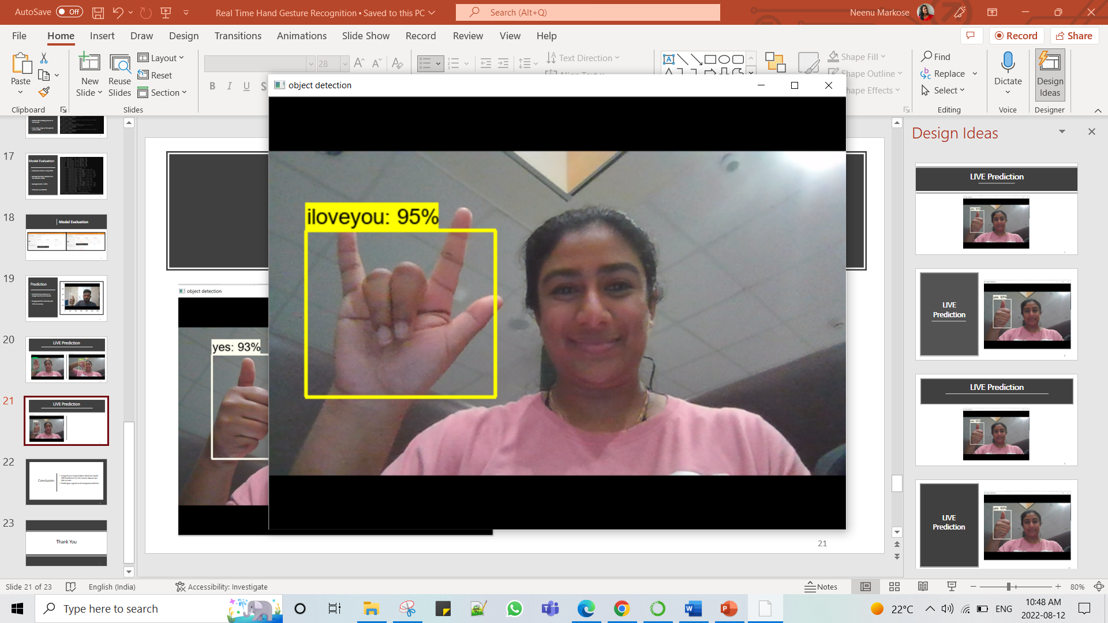
LIVE Prediction

Slide 22
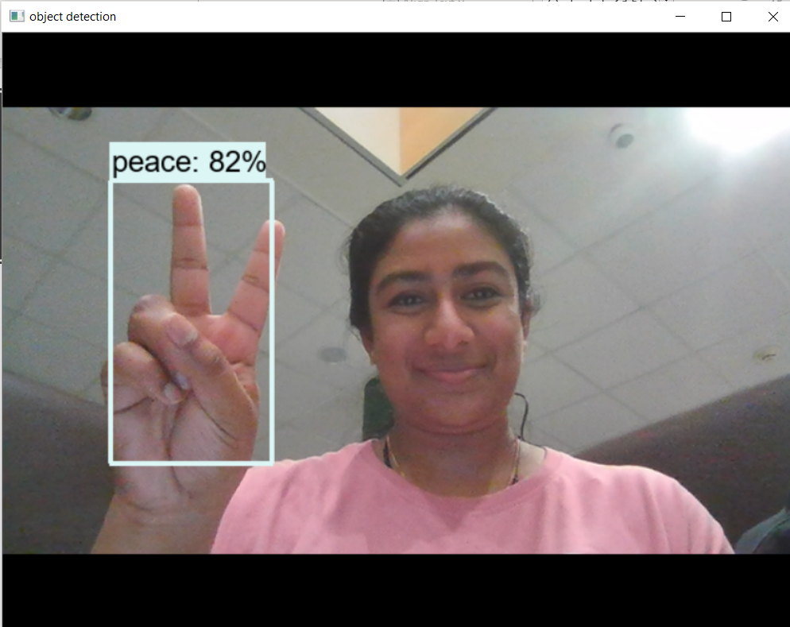
LIVE Prediction

Slide 23
Conclusion
Using the pre-trained object detection model (SSD Mobilenet V2), the custom dataset was able to train.
Model gave a good result and good prediction.

Slide 24
Thank You

